Slide 1
LIVE WITH THE BRAND: TOP SIRLOIN PROFITABILITY
Notes:
Use this page as your title and opening slide.

Slide 2
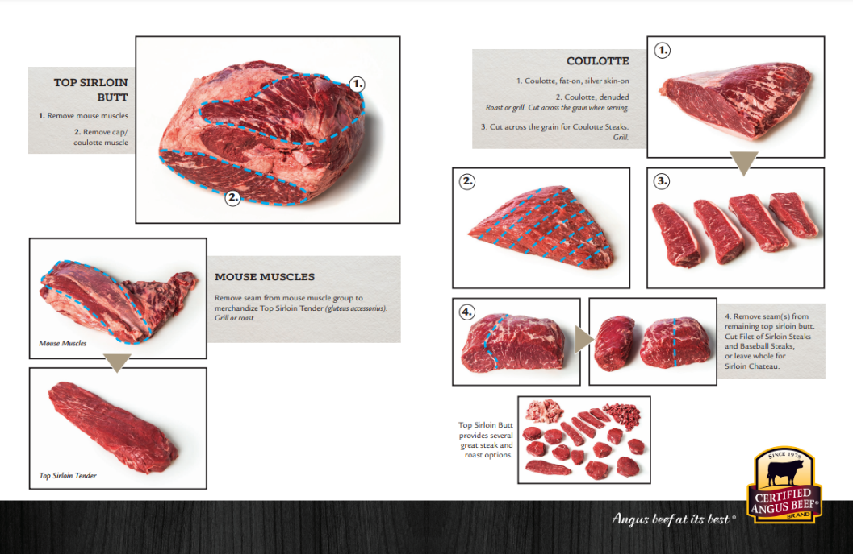

Slide 3
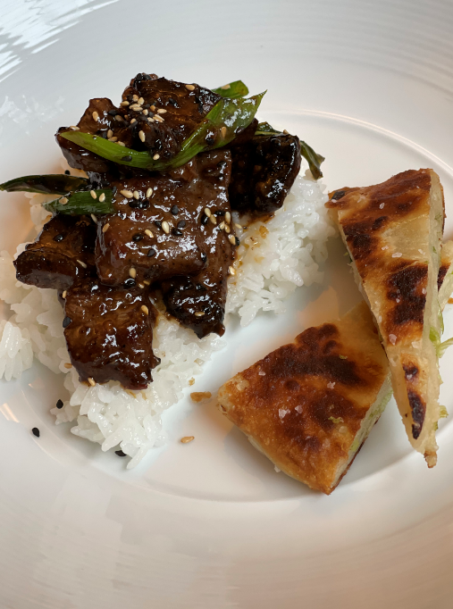
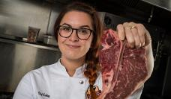
Black Pepper and
Garlic Steak Bites
Chef Ashley
INGREDIENTS:
2 (2 to 3 pounds) Certified Angus Beef ® coulottes, cut into 1 1/2 inch pieces
10 cloves garlic, freshly chopped
2 1/2 tablespoons black pepper
1 tablespoon, plus 1 teaspoon soy sauce
1/4 cup sweet soy sauce
3 teaspoons Worcheshire sauce
1 tablespoon brown sugar
2 tablespoons flour
4 tablespoons cooking oil
3 cups jasmine rice
Sesame seeds and scallions to garnish
Tossing Sauce
1/2 cup sambal chili sauce
1/2 cup sesame oil
1/3 cup oyster sauce

Slide 4
Black Pepper and
Garlic Steak Bites (continued)
Chef Ashley
INSTRUCTIONS:
Cut your steak bites into clean pieces and place in bowl for marinating.
Mix all ingredients into the bowl with the meat and toss steak bites to coat evenly.
Let the steak bites sit for 1 hour in the fridge.
Preheat a large skillet with oil.
Sear the steak bites on each side for 2 minutes, without moving around too much, to create a nice sear.
Immediately toss the cooked steak bites into the tossing sauce, serve over rice and garnish with sesame seeds and lightly charred scallion.
Recipe provided by the Certified Angus Beef ® brand.

Slide 5
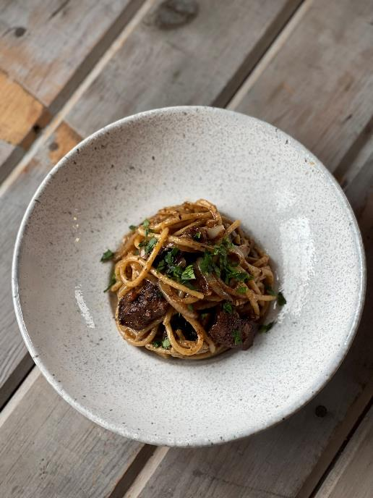
Cajun Steak and Pasta
with Broccolini Tips (serves 2 to 4)
Chef Ashley
INGREDIENTS:
1 (2 to 3 pounds) Certified Angus Beef ® coulotte, cut into 1 inch pieces, fat cap removed
1 box (12 ounce) spaghetti noodles
8 cloves garlic, finely chopped
1 medium onion, thinly sliced
1 cup butter
3 to 4 tablespoons neutral oil
1/2 cup heavy cream
1/4 cup fresh parsley, chopped
Cajun Rub
1 tablespoon paprika
1 1/2 teaspoons garlic powder
1 1/2 teaspoons salt
1 teaspoon onion powder
1 teaspoon dried thyme
1/2 teaspoon dried oregano
1 teaspoon brown sugar
3/4 teaspoon cayenne

Slide 6
Chef Ashley
Cajun Steak and Pasta
with Broccolini Tips (continued)
INSTRUCTIONS:
Mix the Cajun rub together and toss in your steak pieces. Let this sit in the fridge for 1 hour.
Cook your spaghetti noodles while this happens.
Preheat a cast iron pan with 3 tablespoons of neutral oil; sear your steak bites on both sides for about 2 to 3 minutes per side.
Remove the steak pieces from the pan and set aside.
Heat the cast iron pan to medium-high heat (do not clean out the pan; we want the flavor from the Cajun steak pieces in the pasta). Melt butter.
Add onions and garlic. Sauté for about 5 minutes.
Add your heavy cream and bring that to a gentle simmer or until thick (about 2 to 4 minutes).
Immediately add in your cooked spaghetti noodles and gently toss to combine.
Add in the cooked steak pieces and fold.
Garnish with chopped parsley.
Recipe provided by the Certified Angus Beef ® brand.

Slide 7
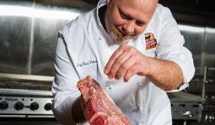
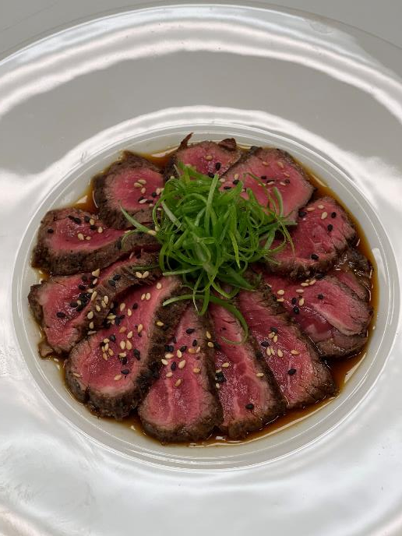
Beef Tataki
Chef Brad
INGREDIENTS:
1 (6 ounce) Certified Angus Beef ® sirloin chateaux
1 ounce soy sauce
2 1/2 teaspoons fresh lime juice
2 1/2 teaspoons fresh lemon juice
1 ounce HonDashi broth
Salt and pepper to taste
Green onions
Sesame seeds

Slide 8
Beef Tataki (continued)
Chef Brad
INSTRUCTIONS:
Cut chateaux into a block; sear to rare, and then freeze for slicing.
Combine broth, soy sauce and juices; season to taste. Julienne green onions and set in ice water to curl.
Pour sauce on a plate. Slice the beef and lay on top in a spiral pattern.
Garnish with green onion curls and sesame seeds.
Recipe provided by the Certified Angus Beef ® brand.

Slide 9
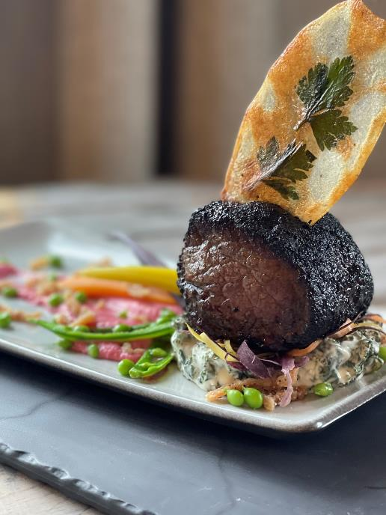
Homerun Baseball Steaks
with Sides (serving size 1)
Chef Brad
INGREDIENTS:
1 (12 ounce) Certified Angus Beef ® baseball-cut sirloin steak
1 Idaho potato
3 cups kale
4 ounces heavy cream
1 teaspoon garlic, freshly chopped
1-ounce white wine
3 tablespoons butter
1 1/2 tablespoons flour
2 ounces beets, cooked and cubed
1-ounce chickpeas
1 teaspoon lemon juice
2 teaspoons tahini
2 cloves garlic
Salt and pepper to taste

Slide 10
Homerun Baseball Steaks
with Sides (continued)
Chef Brad
INSTRUCTIONS:
Grill steak to desired degree of doneness.
For windowpane potatoes, thinly slice potatoes and butter each slice. Sprinkle with herbs of choice, and then press slices together. Bake at 350°F until edges are golden brown.
For creamed kale, make a roux by combining the cream, garlic, wine and seasoning. Cook until thick. Add kale and cook until wilted. Season again before serving.
For hummus, place all ingredients in a food processor and blend until creamy. Season to taste.
Serve dishes together. Enjoy!
Recipe provided by the Certified Angus Beef ® brand.

Slide 11
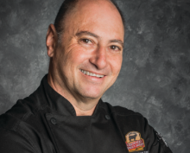
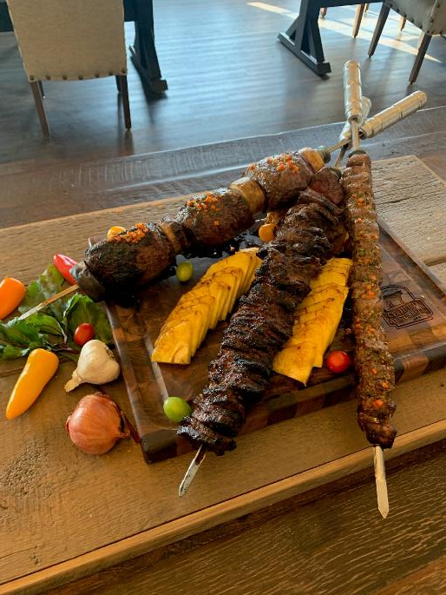
Churrasco-Style Center-Cut
Sirloin Steaks
Chef Peter
INGREDIENTS:
Certified Angus Beef ® center-cut sirloin steaks

Slide 12
Churrasco-Style Center-Cut
Sirloin Steaks (continued)
INSTRUCTIONS:
Remove the chateaux from the top sirloin butt.
Cut four even barrels from the remaining top sirloin butt.
Season with salt and pepper; brush with olive oil.
Place pieces on skewers and grill churrasco style until medium rare (128°F). Allow to rest at room temperature for 5-8 minutes, depending on the size of the barrels.
Slice 1/ 4 inch slices across the grain. Serve with chimichurri and classic sides: garlic bread, homemade sausage, chorizo, bacon, spiced rice, grilled vegetables, potato or egg salad, rice and black beans, plantains, etc.
Recipe provided by the Certified Angus Beef ® brand.
Chef Peter

Slide 13
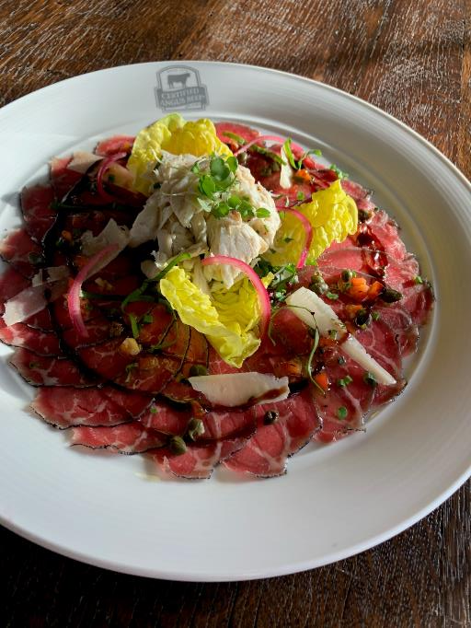
Top Sirloin Chateaux Carpaccio
INGREDIENTS:
Certified Angus Beef ® center-cut sirloin steaks
Balsamic glaze
Shaved Parmigiano-Reggiano
Jumbo lump crabmeat salad
INSTRUCTIONS:
Place the sirloin steaks in the freezer for one to two hours before slicing thin.
Arrange the beef slices on chilled plates.
Top with balsamic glaze, shaved Parmigiano-Reggiano and jumbo lump crabmeat salad.
Recipe provided by the Certified Angus Beef ® brand.
Chef Peter

Slide 14
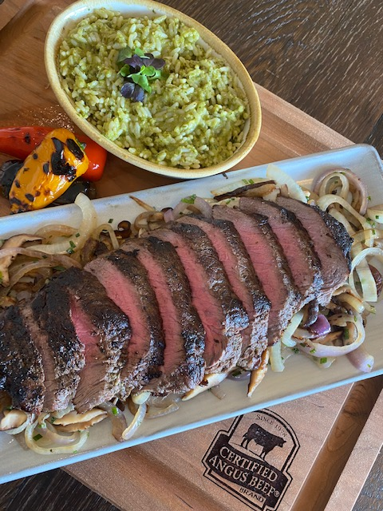
Chimichurri Top Sirloin Steak with Rice Pilaf, Grilled Mushrooms and Onions
INGREDIENTS:
Certified Angus Beef ® top sirloin steaks
1 medium yellow onion, sliced
1 cup mushrooms, sliced
1 tablespoon chives, chopped
2 tablespoons cooking oil
2 tablespoons unsalted butter
Chimichurri:
1 small yellow onion, finely chopped
1 green pepper, finely chopped
1 cup cilantro, chopped
1 cup parsley, chopped
1 tablespoon oregano, chopped
1 cup red wine vinegar
1 cup olive oil
1 teaspoon kosher salt
1/2 teaspoon red pepper flakes
Chef Peter

Slide 15
Chimichurri Top Sirloin Steak with Rice Pilaf, Grilled Mushrooms and Onions (continued)
Rice Pilaf
1 cup white rice
1 cup chimichurri
1 cup beef stock
1/2 cup cooking oil
INSTRUCTIONS:
Begin by making chimichurri. Place onion, pepper, cilantro, parsley and oregano in a medium bowl. Mix before adding vinegar and olive oil. Season with salt and red pepper flakes. Mix again and keep at room temperature.
Season steaks with 1 cup of the chimichurri 3-4 hours before cooking.
Heat oil in a hot skillet. Place in steaks and sear on both sides to develop a rich, caramelized color.
Place on a sheet pan with a wire rake and bake in a hot oven, approximately 10-12 minutes, or until the internal temperature reads 128-130°F.
Chef Peter

Slide 16
Chimichurri Top Sirloin Steak with Rice Pilaf, Grilled Mushrooms and Onions (continued)
INSTRUCTIONS:
Rest steaks for 5 minutes at room temperature. Slice across the grain.
Sauté onions with butter until lightly caramelized; add sliced mushrooms and continue cooking until both are tender and hot. Insert chives, and then season with salt and pepper.
For the rice pilaf, warm oil in a pan. Add rice and beef stock. Gently simmer before adding chimichurri and simmering further.
Remove from heat, cover and bake in 350°F oven for 20 minutes, or until all the liquid is absorbed and rice is tender. Move rice to a bowl to hold until needed.
On a warm plate, place cooked vegetables and top with steak slices. Serve with rice pilaf and fresh chimichurri.
Recipe provided by the Certified Angus Beef ® brand.
Chef Peter

Slide 17
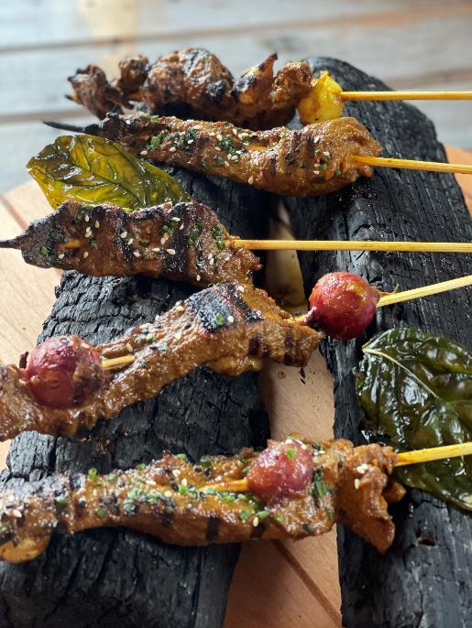
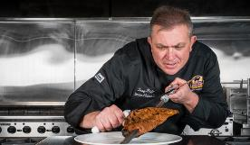
Sirloin Mouse Muscle
Malaysian Beef Satay
Chef Tony
INGREDIENTS:
1 (1 pound) Certified Angus Beef ® sirloin mouse muscle, cut into 1 1/2 inch cubes
Chopped peanuts and cilantro for garnish
Marinade:
1/4 cup peanut oil
1 tablespoon turmeric
1 tablespoon chili powder
1/4 cup soy sauce
2 tablespoons fish sauce
1/4 cup brown sugar
2 tablespoons lime juice
4 cloves garlic, minced
1 thumb ginger, minced

Slide 18
Sirloin Mouse Muscle
Malaysian Beef Satay
(continued)
Chef Tony
Sauce:
1/4 cup unsweetened, natural peanut butter
3 tablespoons water
3 tablespoons lime juice
2 tablespoons sriracha
1 tablespoon fish sauce
2 tablespoons honey (or brown sugar)
1 clove garlic, minced

Slide 19
Sirloin Mouse Muscle
Malaysian Beef Satay
(continued)
Chef Tony
INSTRUCTIONS:
Combine all marinade ingredients in a large bowl. Whisk well.
Add beef to marinade and mix. Marinate at room temperature for 1 hour. (If marinating for longer, do so in refrigerator for food safety.)
Combine all sauce ingredients in a blender and mix until smooth. If sauce is too thick, add 1-2 tablespoons of more water and blend again. Transfer to a bowl and set aside.
Thread beef onto skewers while preheating grill to medium-high heat. Brush oil onto grill grates and place beef skewers on top. Cook until both sides are charred, approximately 2-3 minutes per side.
Remove and place on a serving plate. Garnish with peanuts and cilantro. Serve with sauce.
Recipe provided by the Certified Angus Beef ® brand.

Slide 20
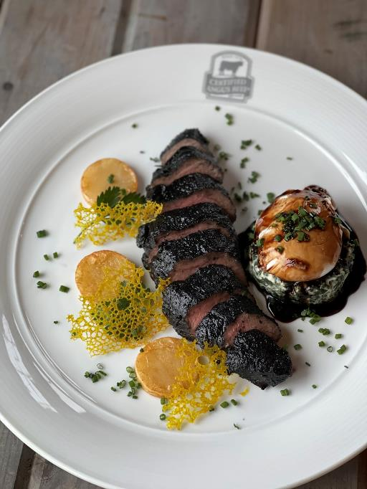
Charcoal-Rubbed
Sirloin Steaks
Chef Tony
INGREDIENTS:
1 (1 pound) Certified Angus Beef ® sirloin mouse muscle
1 tablespoon charcoal powder
1 tablespoon Kosher salt
1 tablespoon black pepper
3 tablespoon olive oil
Merlot Sauce
1/4 cup water
1/4 cup sugar
3 tablespoons red wine vinegar
1 cup onion, finely chopped
3 tablespoons unsalted butter
2 cups Merlot or other dry red wine
1 cup rich veal stock or demi-glace

Slide 21
Charcoal-Rubbed Sirloin Steaks
(continued)
Chef Tony
Poached Egg
1 fresh egg, cold
1 teaspoon kosher salt
2 teaspoons white vinegar
INSTRUCTIONS
Blend charcoal powder, salt and black pepper. Wear gloves to prevent staining hands with charcoal powder.
Rub beef generously with the seasoning and set aside.
In a small pan, add oil; heat until smoking. Sauté beef one minute on both sides. Place in a preheated 400°F degree oven until internal temp reaches 115°F.
Remove and rest.
For the sauce, bring water and sugar to a boil in a
small saucepan. Stir until sugar is dissolved. Boil
without stirring until achieving golden caramel
color. Remove pan from heat.

Slide 22
Charcoal-Rubbed Sirloin Steaks
(continued)
Chef Tony
Carefully pour vinegar down side of pan to steam and harden caramel. Continue cooking over moderate heat, stirring until dissolved, for about 3 minutes. Remove pan from heat.
In another pan, cook onion in butter over moderate heat for about 5 minutes, or until golden. Stir in wine; let boil until mixture is reduced to 1 cup, approximately 15 minutes.
Stir in stock and boil until mixture is reduced to 2 cups, approximately 10 minutes.
Remove from heat; stir in caramel.
Pour sauce through a sieve into a bowl. Note: sauce may be made two days ahead, cooled completely and chilled covered. Reheat sauce before serving.
For the poached egg, heat enough water to cover
1 inch of a 2 quart saucepan. Add 1 teaspoon
kosher salt and 2 teaspoons white vinegar;
bring to a simmer over medium heat.

Slide 23
Charcoal-Rubbed Sirloin Steaks
(continued)
Chef Tony
Crack 1 very fresh, cold and large egg into a cup or small ramekin.
Quickly stir the water in one direction until it’s smoothly spinning around. Tip: Use this whirlpool method when poaching a single serving (1-2 eggs). For bigger batches, heat the water, salt and vinegar in a 12-inch nonstick skillet and do not stir.
Carefully drop the egg into the center of the whirlpool. The swirling water will help prevent the white from "feathering," or spreading out in the pan.
Turn off the heat, cover the pan and set your timer for 5 minutes. Don't peek, poke, stir or accost the egg in any way.
Remove the egg with a slotted spoon and serve immediately with sliced steak, topped with sauce and complete with a side of fried breakfast potatoes.
Recipe provided by the Certified Angus Beef ® brand.

Slide 24
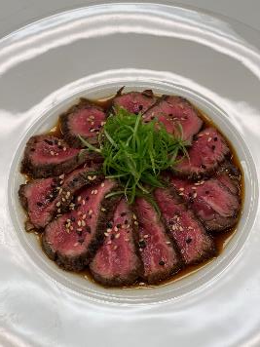
Contact kbarnes@certifiedangusbeef.com to arrange a one-on-one consultation with one of our chefs.

