Slide 1
LIVE WITH THE BRAND:
Rib Innovation

Slide 2
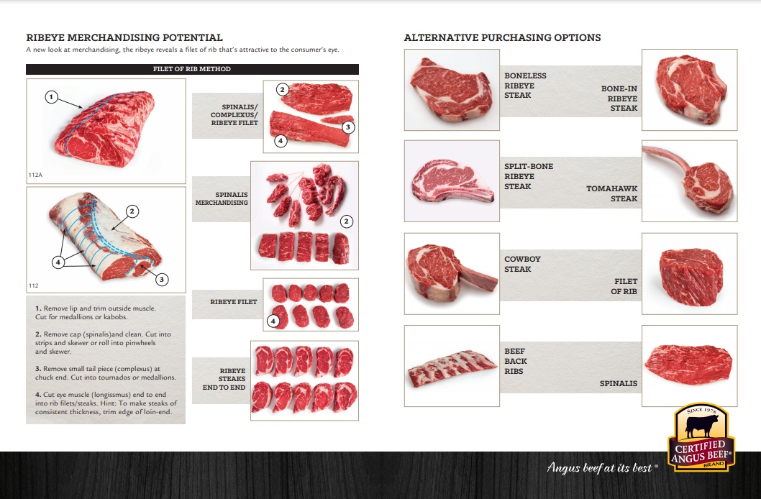

Slide 3
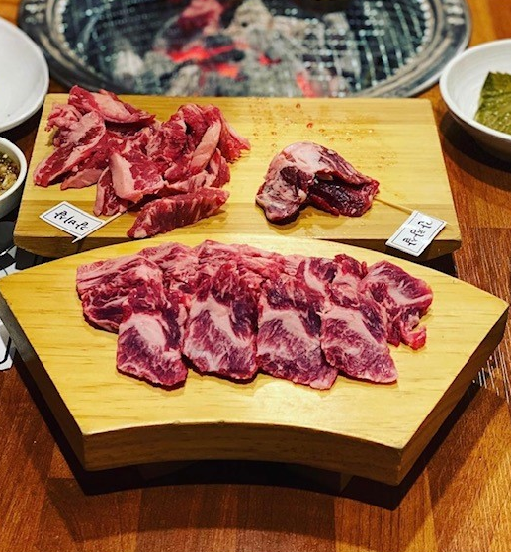
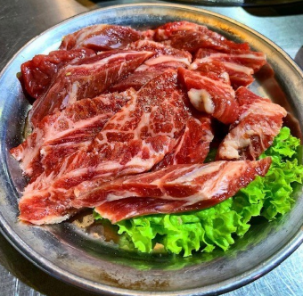
Cooking Methods:
Grill, Hot Pot, Korean Barbecue
Suggested Degrees of Doneness:
Medium Rare/Medium
Flavor Profile:
Sticky, Sweet Glazes, Barbecue Sauces
RIB FINGERS

Slide 4
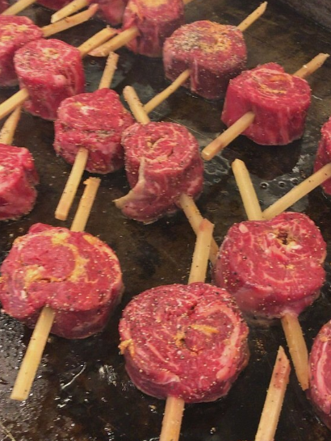
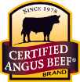
Spinalis Pinwheels
Cooking Methods:
Grill, Pan Sear
Suggested Degree of Doneness:
Medium
Flavor Profile:
Sticky, Sweet Glazes, Dry Rubs

Slide 5
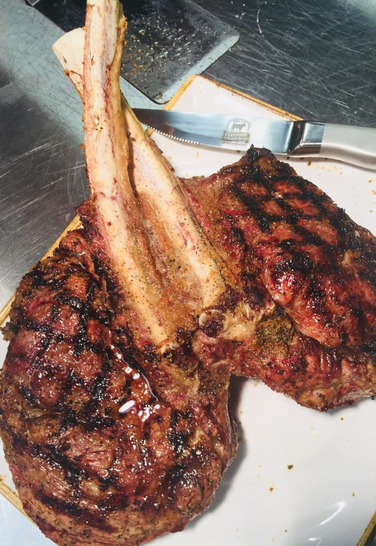
Scorpion Steak
Cooking Methods:
Grill
Suggested Degree of Doneness:
Medium Rare/Medium
Flavor Profile:
Simple Seasoning, Dry Rubs

Slide 6
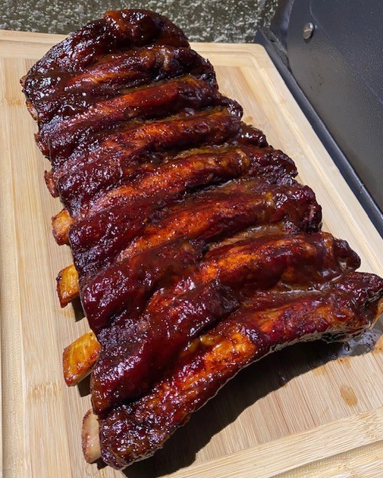
Back Ribs
Cooking Methods:
Short Braise, Smoke
Suggested Degree of Doneness:
At Least 160°F
Flavor Profile:
Sticky Glazes, Barbecue Sauces, Dry Rubs

Slide 7
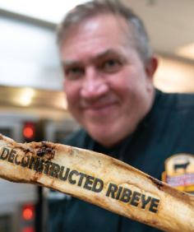
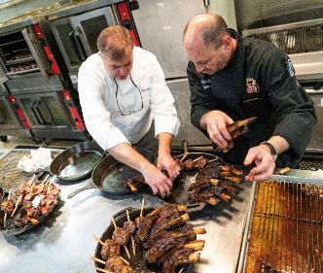
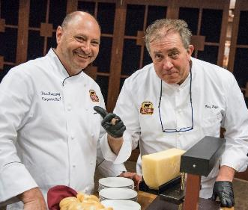
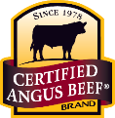
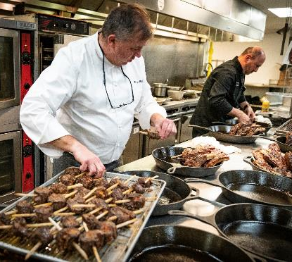
Personalized
Cut Ideation
Available
Contact us for
more information. cs@certifiedangusbeef.com
Notes:
Too corporate looking

