Slide 1
LIVE WITH THE BRAND:
Chuck Resources

Slide 2
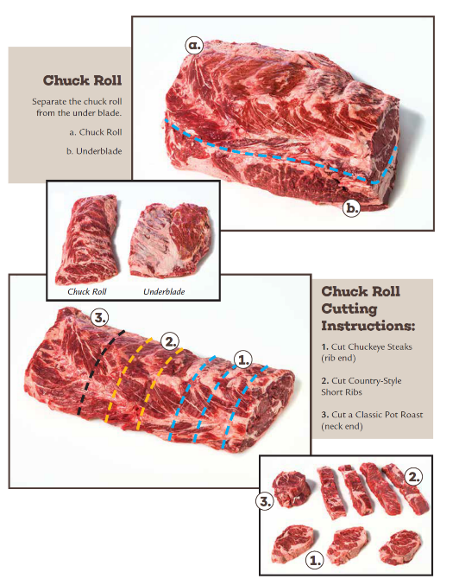
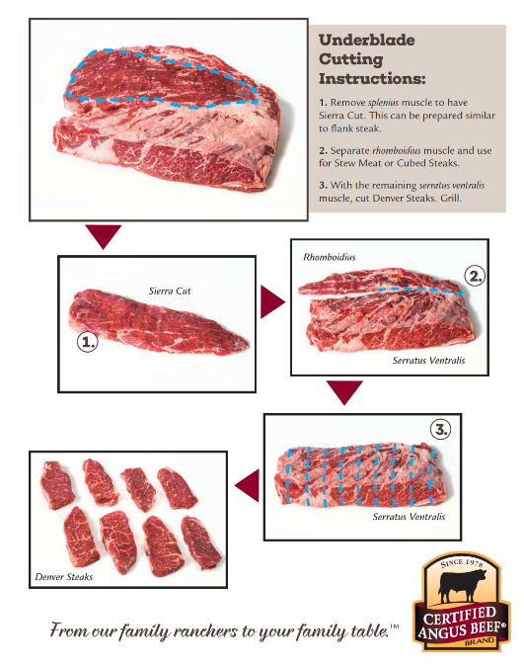

Slide 3
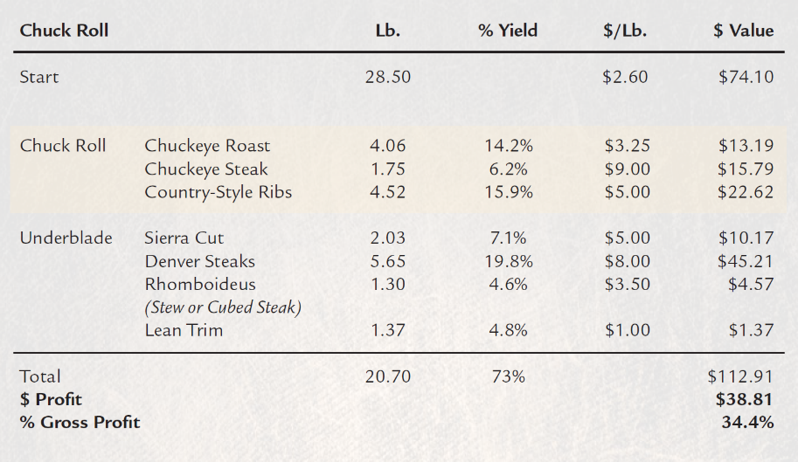
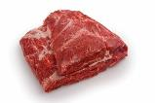

Slide 4
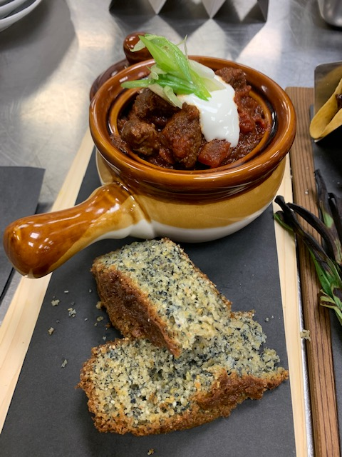
Colorado Chili with
Certified Angus Beef ® Chuck
INGREDIENTS:
2 pounds Certified Angus Beef ® chuck roast, cut into 1-inch cubes
3 dried ancho chilies, stems and seeds removed, torn into pieces
3 dried guajillo chilies, stems and seeds removed, torn into pieces
3 dried New Mexico chilies (or pasilla), stems and seeds removed, torn into pieces
4 cups beef stock, divided
2 teaspoons kosher salt
1 teaspoon black pepper
2 teaspoons canola oil
3 cloves garlic, minced
1/2 cup diced onion
2 teaspoons ground cumin
1 teaspoon dried oregano

Slide 5
Colorado Chili with
Certified Angus Beef ® Chuck (continued)
DIRECTIONS:
In a saucepan, toast the chilies over medium heat for 1-2 minutes to bring out their flavor; add 2 cups beef stock and bring to a gentle boil. Turn off heat, cover and steep for 25 minutes.
Season beef cubes with salt and pepper. In a large saucepan or Dutch oven, heat canola oil over medium-high heat and sear on two sides, working in batches, about 5 minutes.
Reduce heat to medium, add garlic, onion, cumin and oregano; sear with beef cubes for 2-3 minutes. Add 2 cups beef stock and bring to a gentle boil, and then transfer to a slow cooker set to high, covered.
Transfer chilies and their broth to a blender and puree until smooth. Add chili puree to beef; stir and cook on high setting for 1 hour. Reduce to low setting, remove lid and cook for an additional 2 hours, stirring periodically. It should be thick with a rich mahogany color.
GARISH / SERVE WITH:
Sour cream, scallion and cornbread

Slide 6
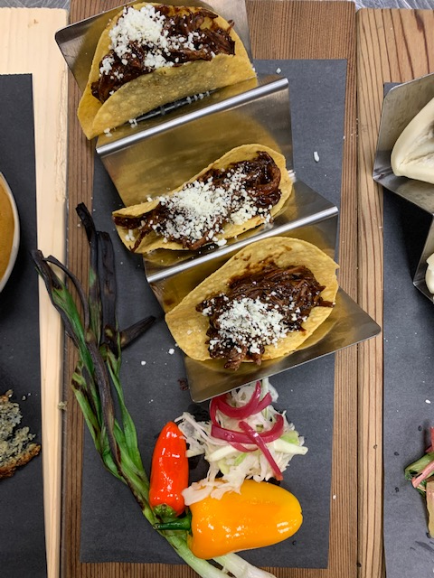
Certified Angus Beef ® Smoked Chuck Roll Tacos
INGREDIENTS:
6 ounces Certified Angus Beef ® smoked, shredded chuck
3 corn tortillas, deep fried
3 ounces mole sauce
½ ounce Cojita cheese, on each
DIRECTIONS:
Toss the smoked and shredded chuck in the mole sauce.
Fill your freshly fried tortillas with the mole chuck.
Top with cheese, crème and cilantro.
Garnish as desired.
GARISH / SERVE WITH:
Grilled pepper
Grilled scallion
Fresh crème
Fresh cilantro

Slide 7
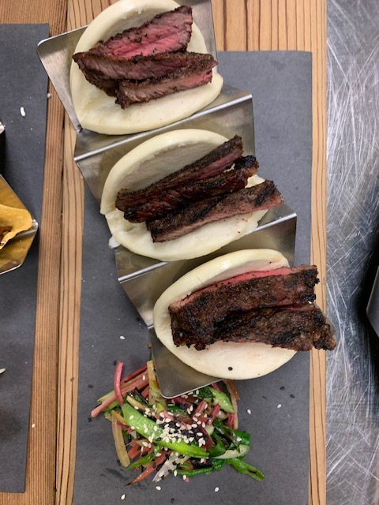
Certified Angus Beef ® Denver Steak Bau Buns
INGREDIENTS:
12 ounce Certified Angus Beef ® Denver steak, grilled and sliced
3 steamed bao buns
3 ounces sriracha-honey mayo
6 ounces crisp Asian slaw
DIRECTIONS:
Spread mayo in each bao bun before stuffing with beef.
Slice the grilled Denver steak, and then stuff 4 ounces in each steamed bun.
Top buns with cold, crisp Asian slaw and fresh scallions.
GARISH / SERVE WITH:
Fresh scallion and sesame seeds

Slide 8
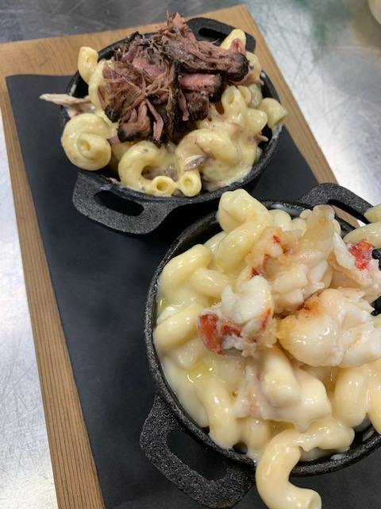
Certified Angus Beef ®
Shredded Chuck Macaroni and Cheese
(lobster add in as option)
INGREDIENTS:
8 ounces Certified Angus Beef ® chuck, cooked and shredded
2 cups Béchamel cheddar sauce, properly seasoned
2 cups cooked macaroni
DIRECTIONS:
Combine all ingredients and bake individual portions.
GARISH / SERVE WITH:
Optional bread crumb topping

Slide 9
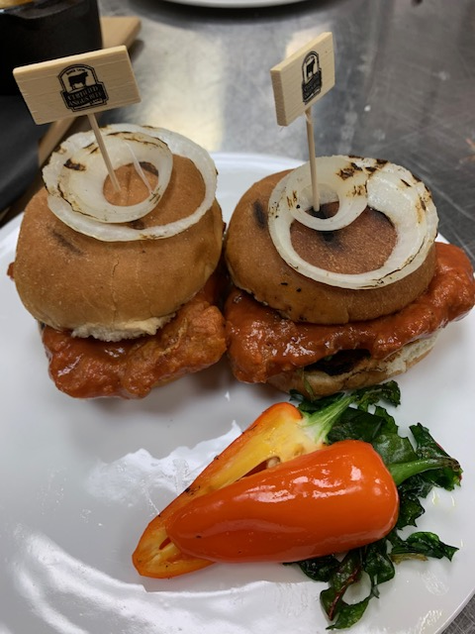
Certified Angus Beef ® Nashville Hot Slider
INGREDIENTS:
6-8 ounce portion Certified Angus Beef ® neck hump, pounded out to ¼ inch thickness
Dredge mixture for breading
Oil for frying
2 cups Frank’s RedHot
1 cup melted butter
2 tablespoons honey
Pickle chips
DIRECTIONS:
Pound out beef to ¼ inch thick, season, dredge and fry until golden brown and cooked through.
Douse in mixture of equal parts Frank’s sauce and melted butter.
Serve on toasted slider buns, with pickle and honey.
GARISH / SERVE WITH:
Grilled onions

Slide 10
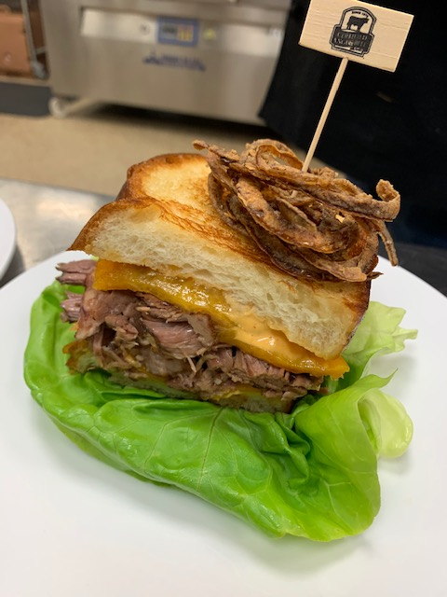
Certified Angus Beef ® Loaded Short
Rib Grilled Cheese
INGREDIENTS:
6 ounces Certified Angus Beef ® short rib, cooked and shredded
Thick-cut sourdough bread
Butter
2 slices Swiss cheese
2 slices Monterey jack
3 tablespoons spicy mayo of choice
1 tablespoon dijon
DIRECTIONS:
Traditional grilled cheese technique using shredded short rib as the main star of the show.
GARISH / SERVE WITH:
Pickle, tomato or grilled onion

Slide 11
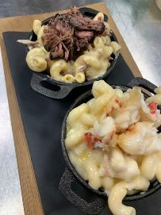
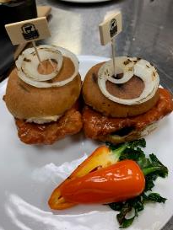
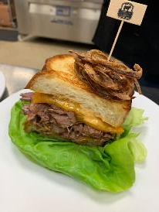
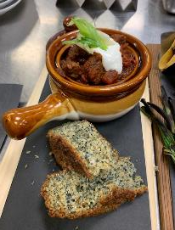
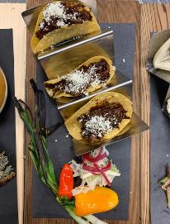
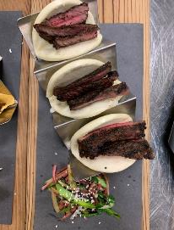
QUESTIONS?

